Slide 1
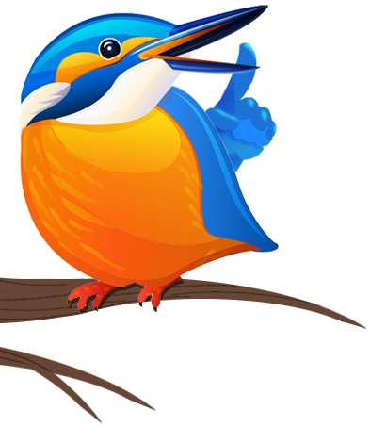
Birds
www.laganvalleylearning.co.uk

Slide 2
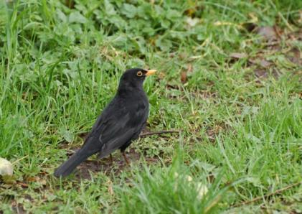
Blackbird
Habitat: Found almost everywhere, gardens, woodlands, countryside and by the coast
Food: Worms, insects, fruits and berries.
Nest site: In hedgerows
Interesting Facts:
Female blackbirds have brown feathers. Blackbirds like to sing after it rains.

Slide 3
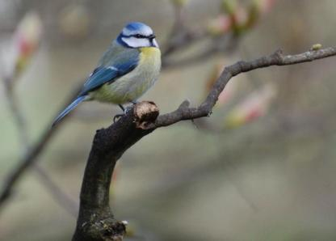
Blue tit
Habitat: Common in woodlands and gardens.
Food: Mainly insects, they love juicy caterpillars. The will also eat seeds in winter.
Nest site: Hole in tree or a nest box in your garden.
Interesting facts:.
Blue tits have been seen nesting in made-made objects such as post boxes, traffic lights and watering cans!

Slide 4
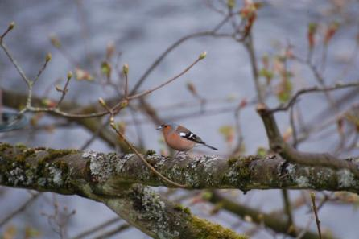
Chaffinch
Habitat: Woodlands, hedgerows, fields and parks.
Food: Seeds in winter, insects in summer.
Nest site: Hedgerows and trees
Interesting facts:.
A group of finches is known as a ‘charm’.

Slide 5
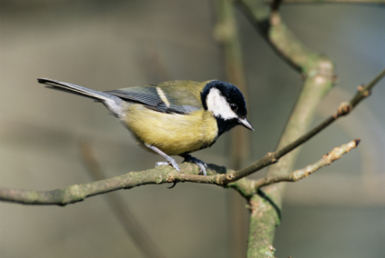
Great tit
Habitat: Woodlands, parks and gardens.
Food: Seeds in winter, insects in summer.
Nest site: Hole in tree or a nest box in your garden.
Interesting facts:
The great tit spends 75 percent of its day searching for food.

Slide 6
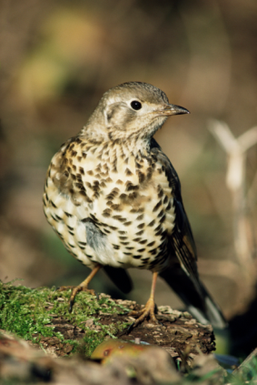
Song thrush
Habitat: Woodlands, hedgerows, parks and gardens.
Food: Worms, slugs, snails and berries.
Nest site: Hole in tree or hedges
Interesting fact:
They smash snail's shell against an anvil (usually a rock). Blackbirds often steal the snail after the Song Thrush has cracked it open.

Slide 7
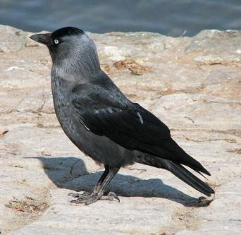
Jackdaw
Habitat: Woodlands, fields, parks, gardens, grasslands and coast.
Food: Insects, seeds and scraps of food from humans
Nest site: Tree tops and old buildings.
Interesting fact: Jackdaw is a member of the crow family. Crows are considered to be the most intelligent birds. They have a reputation of being thieves of shiny objects.

Slide 8
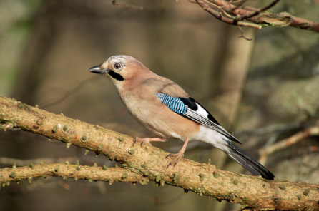
Jay
Habitat: Woodlands and parklands.
Food: Acorns and other seeds, insects and small mammals
Nest site: Woodland tree tops.
Interesting fact: Jays are like pirates they bury their treasures (acorns). They have an excellent memory and remember where they have stashed their food for winter.

Slide 9
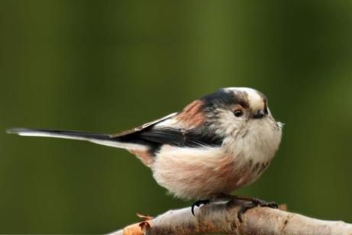
Long-tailed tit
Habitat: Woodlands, hedgerows, parks and gardens.
Food: Mainly insects but also seeds.
Nest site: Hedgerows and trees.
Interesting fact:
You will see these birds in large flocks. At night they roost huddled together to keep warm.

Slide 10
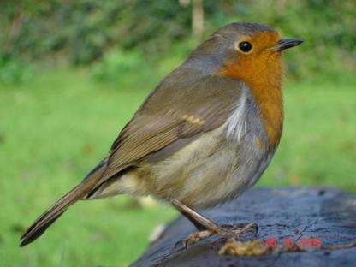
Robin
Habitat: Woodlands, hedgerows, parks and gardens.
Food: Seeds, insects worms and berries.
Nest site: Trees and hedgerows
Interesting fact:
Robins can become quite tame. They can even be encouraged to eat from your hand.

Slide 11
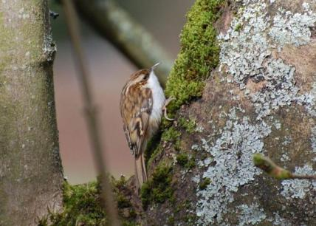
Treecreeper
Habitat: Woodlands, parkland
Food: Mainly insects however may eat seeds in winter
Nest site: Cracks in trees
Interesting fact: Treecreepers forage for food in the bark of trees. They start at the bottom of the tree and spiral up the trunk looking for insects.

Slide 12
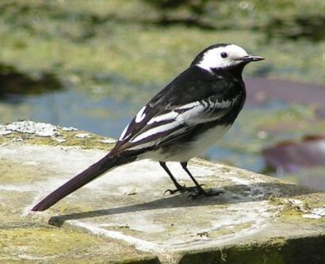
Pied Wagtail
Habitat: Almost everywhere, parks, gardens, towns, coast, grasslands and woodlands
Food: Mainly insects
Nest site: Cracks in trees, holes in walls.
Interesting fact:
Some people call this bird ‘wee willy wagtail’. As its name suggests it constantly wags its tail.

Slide 13
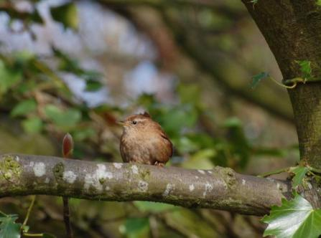
Wren
Habitat: Woodlands, parks, gardens and farmland.
Food: Mainly insects and spiders.
Nest site: Cracks in trees and hedgerows.
Interesting fact:
Wrens are one of our smallest birds, usually measuring 9cm in length

Slide 14
www.laganvalleylearning.co.uk

