Slide 1

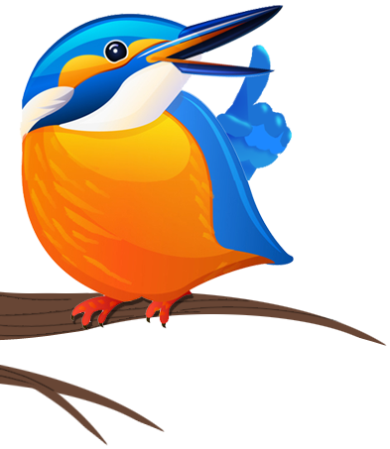
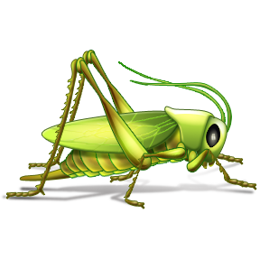


Minibeasts
www.laganvalleylearning.co.uk

Slide 2

What is a minibeast?
A minibeast is a small animal or ‘creepy crawly’.
Minibeasts have no backbone .
Minibeasts do not have a skeleton on the inside.
Some minibeasts have a hard shell to live in.
Minibeasts can be found on land, water and air.
There are lots of different kinds of minibeasts. Can you name any?

Slide 3
How are minibeasts different from us?
We have our skeletons inside our bodies. Minibeasts have their skeletons outside their body.
Minibeasts have soft bendy bodies.
Some minibeasts have a hard shell to protect them.
Worms have soft bodies
Snails have soft bodies and a hard shell

Slide 4
What do minibeasts need to survive?
Food
Water
Shelter

Slide 5

What do minibeasts eat?
Some minibeasts eat plants…
they are called herbivores.
Some minibeasts only eat meat…
they are called carnivores.
Some minibeasts eat both plants and meat…
they are called omnivores.

Slide 6

What do minibeasts live?
A minibeast’s home is called a habitat
A habitat is where a minibeast lives. It is more than just a home as it includes everything an animal needs to survive (food, water and shelter). A habitat could be as big as a forest or as small as a leaf.
Can you think of a good habitat for a minibeast?

Slide 7
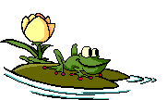
Can you think of any minibeasts that might live in these habitats?
Under a log
On a plant or tree
In the soil
In a pond

Slide 8
Sorting minibeasts
You can sort minibeasts by the number of legs they have.
0 legs = Worms, snails, slugs
6 legs = Insects; beetles, butterflies, bees, ladybirds
8 legs = Spiders
14 legs = Woodlouse
More than 14 legs = Millipedes and Centipedes

Slide 9
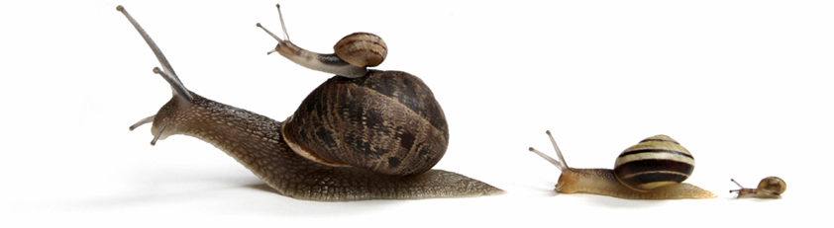
Slugs and snails
Live in dark, damp habitats. Can you think of a good snail habitat?
Have soft bodies and sometimes hard shell
Have long tentacles with eyes on them
They eat plants so they are called herbivores
What do you think eats slugs and snails?
Tentacles
With eyes
Tentacles
for smelling
Shell

Slide 10
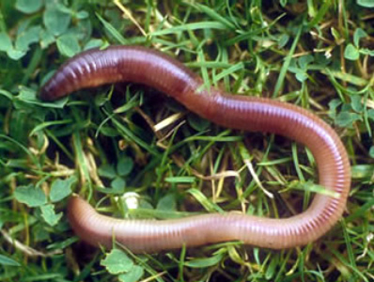
Earthworms
Earthworms live in the soil.
They have soft bodies that are made of segments.
They eat soil and make it healthy for trees and plants to grow.
They have a mouth but no eyes or nose.
Can you think of anything that might eat worms?

Slide 11
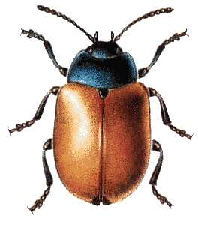
Insects
Insects have 6 legs.
They have feelers called antennae to smell and feel.
Insects have 3 body parts
Head
Thorax (Belly)
Abdomen (Bottom)
Some insects have wings.
Some insects are herbivores and some are carnivores.
Can you label this insect?

Slide 12
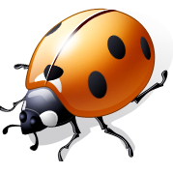
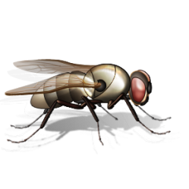
How many insects can you name?
Ladybird
Butterfly
Bee
Ant
Grasshopper
Beetle
Fly
Dragonfly

Slide 13
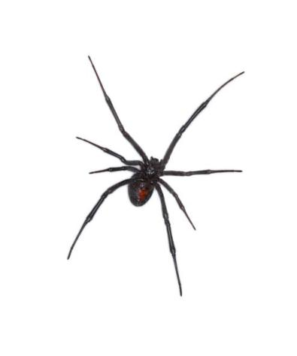
Spiders
Spiders have 8 legs.
They have a hard outer skeleton.
They do not have antennae.
They use their front legs for catching food.
They are carnivores.
Some spiders spin webs to catch their prey.
Some spiders hide and pounce on their prey.
Spiders are predators.

Slide 14
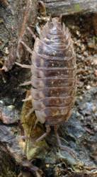
Woodlice
Woodlice have 14 legs.
They have 2 antennae.
They have a hard outer skeleton.
They live in dark damp habitats.
They are herbivores.
They are related to crabs and lobsters.
As they grow they moult. This means that
they shed their old skin and grow a new one!
Some people call them slaters

Slide 15
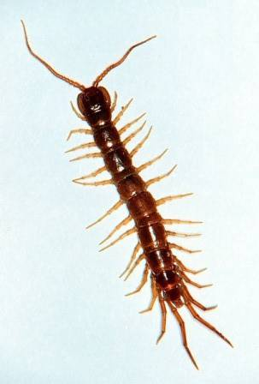
Centipedes
Centipedes are reddish brown.
They have 2 antennae.
They have segmented bodies.
They have 1 pair of legs on each body segment.
They usually have about 15 pairs of legs and can move very fast.
They are carnivores and even eat other centipedes!
They are predators.

Slide 16
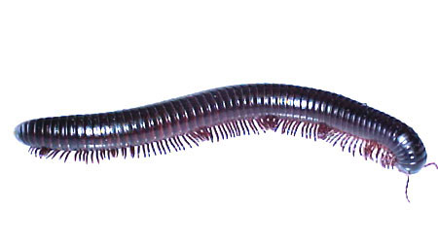
Millipedes
Millipedes live in the soil.
Their body is made of segments.
They have 2 pairs of legs on each body segment.
They are herbivores.
If they are frightened they roll up into a ball.

Slide 17
Helpful minibeasts
Some bees make honey.
All bees help flowers to grow.
Worms make the soil healthy for plants to grow.
Ladybirds help gardeners by eating aphids.
Can you think of any harmful minibeasts?

Slide 18
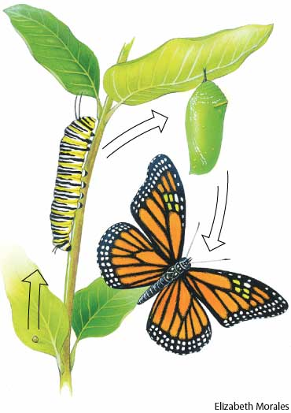
Lifecycle
Some minibeasts have a life cycle where the young minibeast is very different from the adult.
Look at the life cycle of a butterfly.
Can you see the 4 different stages?
3.
2.
4.
Can you put these in the right order?
Chrysalis, Egg, Butterfly, Caterpillar
1.

Slide 19
www.laganvalleylearning.co.uk

