Slide 1




Pond life
www.laganvalleylearning.co.uk

Slide 2


What is a pond?
A pond is a hollow in the ground where water collects.
Ponds are different to rivers. Rivers are fast flowing but in a pond the water is still.
Ponds are teeming with life. Some creatures live in the water some live on the water and some live around the edge of the pond.
A pond is a great habitat as it can provide; food, shelter and water to many different species.
Can you name any living things that might use a pond as their habitat?

Slide 3
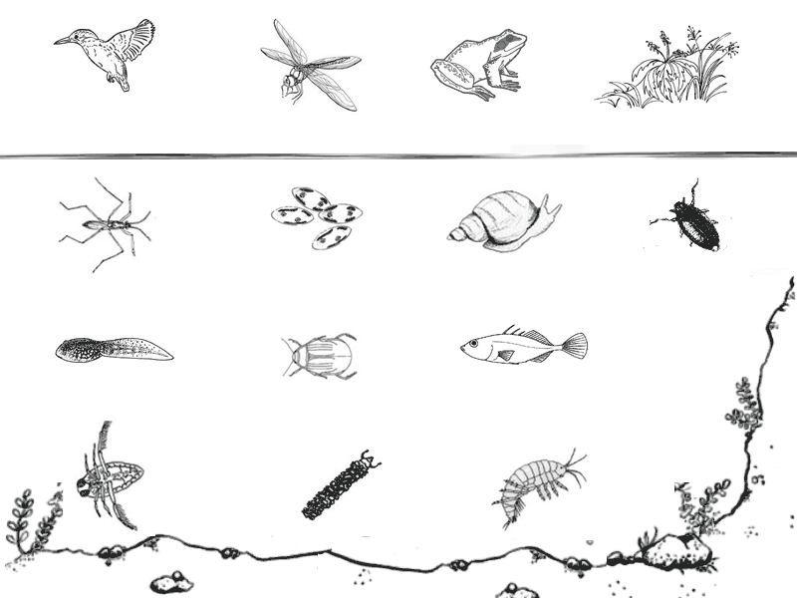
Pond Life
Above water
Kingfisher
Dragonfly
Frog
Plants
Surface
Pond Skater
Algae
Pond snail
Whirligig Beetle
Under Water
Tadpole
Diving Beetle
Fish
Water Boatman
Caddis Fly Larva
Shrimp
Bottom

Slide 4
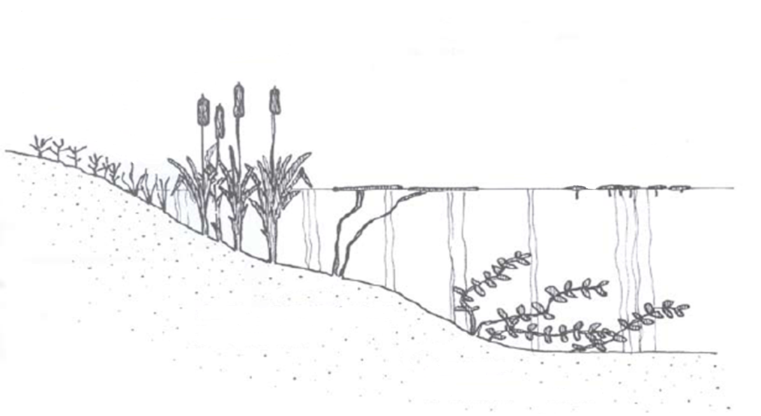
Pond plants
Plants are really important for ponds. They provide food, shelter and oxygen. The smallest plants in a pond are called algae. They are so tiny you need a microscope to see them but they provide food for many small pond creatures.
Reed mace with roots under water
Marsh and swamp plants
Water lily with floating leaves
Floating plants (algae)
Roots underwater
Underwater plants e.g. pond weed

Slide 5
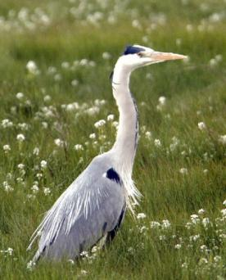
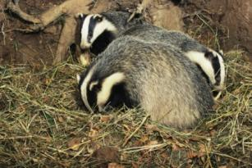
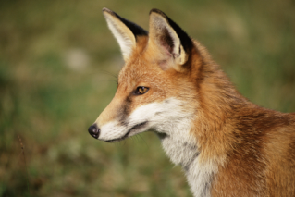
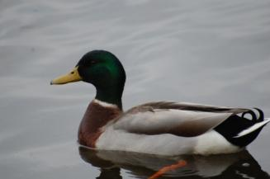
Life on the edge
Water is essential for all living things. Ponds are visited by birds and mammals looking for something to eat or drink.
Here are some of the visitors you might find.
If you’re not lucky enough to see these animals, look for tracks on the water’s edge.
Heron
Badger
Fox
Mallard duck

Slide 6
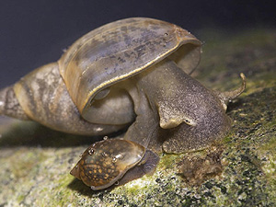
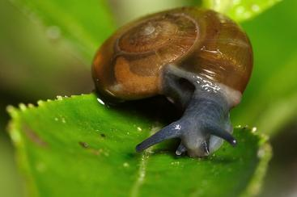
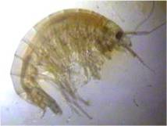
What lies beneath?
Underneath the water there is a whole world of weird and wonderful creatures that have some amazing adaptations for living in this environment.
There are two kinds of snails you will find beneath the water. Left is a pond snail and right a ramshorn snail.
They are herbivores and eat algae. They have gills to breathe and hold air in their shells. When
this air runs out they come up to the surface for more.
Shrimp are crustaceans and are related to crabs, lobsters and woodlice. They have 7 or 9 pairs of legs and breathe using gills. They can only live in clean water where there is no pollution.

Slide 7
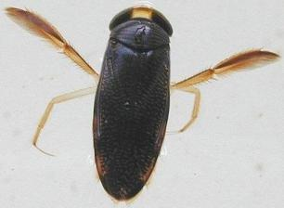
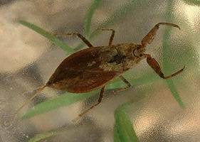
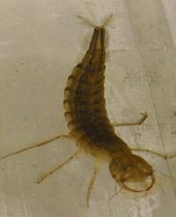
Water bugs
Water boatman
Water scorpion
Diving beetle larvae
This insect swims upside down using it’s legs like rowers on a boat. It can’t breathe underwater so frequently has to come up to the surface.
This bug has huge pinchers and it looks like a scorpion but is harmless to humans. It uses its long tail as a snorkel to breathe air.
This is the largest larva in the pond and it is a fierce predator. It even eats tadpoles!!!

Slide 8
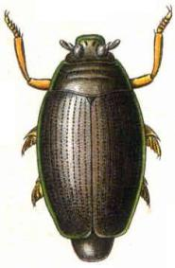
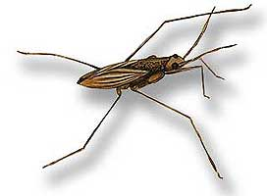
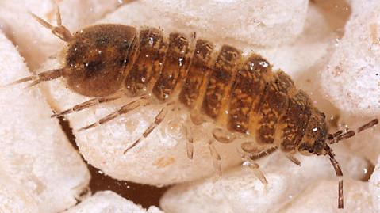
More water bugs
Whirligig Beetle
Pond Skater
Water Louse
This insect traps a bubble of air under its tummy so it can stay underwater for a long time. It gets its name because it swims around in a circle when it is alarmed.
This insect can be found on the surface of the water. The have very long legs and can stand on the surface of the water without getting their legs wet.
This insect has 14 legs and can be found under stones. It eats algae and rotten matter.

Slide 9
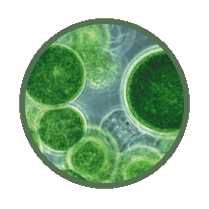
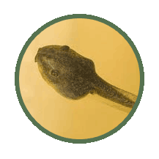
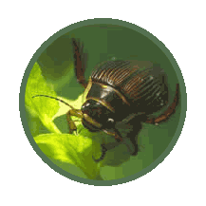
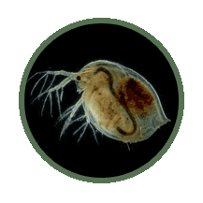
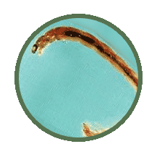
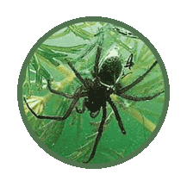
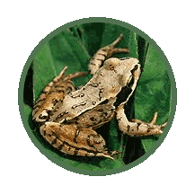
Who’s eating who?
Algae
Tadpoles
Diving beetle
EATEN BY
EATEN BY
Green plants are called producers because they make their own food.
Animals are called consumers because they get their food from other plants and animals.
Animals which hunt other animals are called predators.
Algae
Water Flea
Midge larva
Water spider
Frog

Slide 10
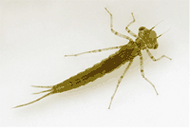
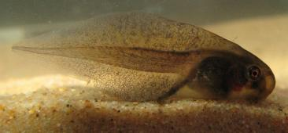
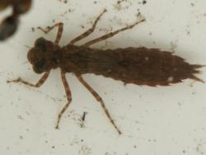
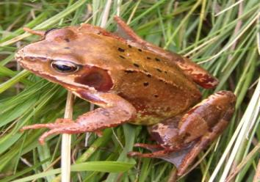
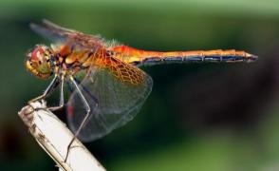
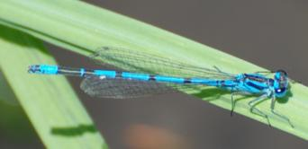
Water babies
Some pond creatures only spend part of their life underwater, the rest they spend on land or in the air. Here are some you might encounter.
Tadpole
Damselfly nymph
Dragonfly nymph
Adult damselfly
Common frog
Adult dragonfly

Slide 11



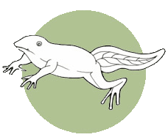
Life cycle of a frog
Frogspawn
Frogs lay thousands of eggs in one go! Many other animals feast on them before they have a chance to grow into frogs.
FROGSPAWN
FROG
We only have one type of frog in Ireland, the common frog
TADPOLES
12 weeks front legs formed
FROGLET

Slide 12

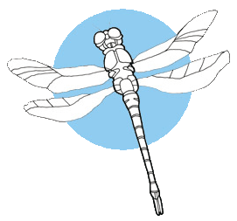
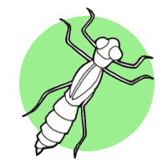
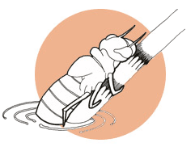
Life cycle of a dragonfly
There are 22 species of dragonfly in Ireland.
The larva can live in the pond for up to 5 years.
Adult dragonflies only live for 1 or 2 weeks.
EGGS
DRAGONFLY
NYMPH
EMERGING DRAGONFLY

Slide 13
www.laganvalleylearning.co.uk

