Slide 1


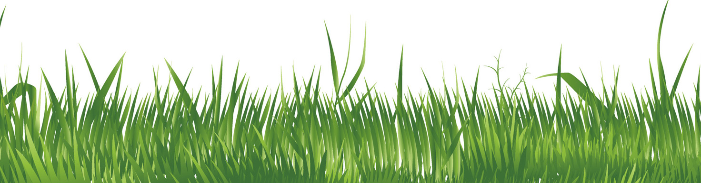

Trees
Of the Lagan Valley
Regional Park
www.laganvalleylearning.co.uk

Slide 2
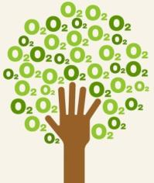

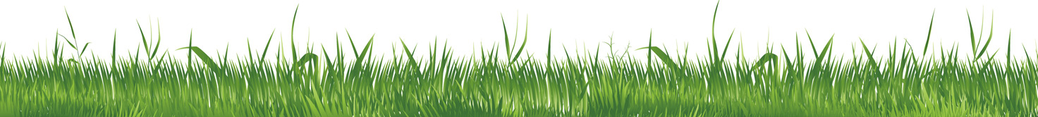
Why are trees important?
Trees are amazing, they do many jobs that are very important to animals, people, and the environment.
Can you think of any important things that trees do?
Here are some clues:
Oxygen to breathe
Homes for wildlife
Food for wildlife
Paper and food
Timber

Slide 3
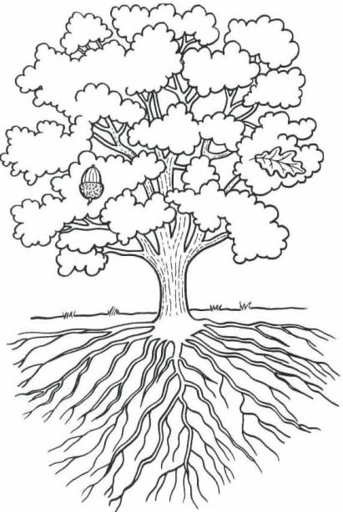
Can you name the parts of a tree?
Leaf
Seeds
Branch
Trunk
Roots
What parts of the tree would these creatures live in?

Slide 4
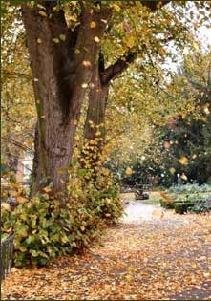
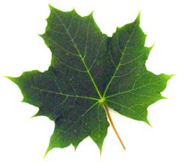
Deciduous trees
Deciduous trees are also known as broadleaf trees for example a sycamore leaf is broad and flat.
They loose the leaves in the autumn. The leaves make a carpet of leaf litter on the woodland floor. This is a great habitat for minibeasts and small mammals.
Deciduous trees have hard wood which can be used for making very strong furniture.
They take a long time to grow.

Slide 5
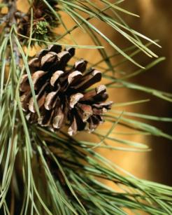
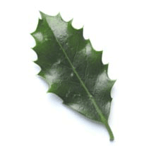
Evergreen trees
Evergreen trees are also known as
conifers because some of them produce cones.
Many evergreens have needle shaped leaves, which they keep throughout the winter.
Holly is an exception, it is an evergreen tree that has a broad shaped leaf.
Evergreen trees grow more quickly.
Pine cone
Needle leaves

Slide 6
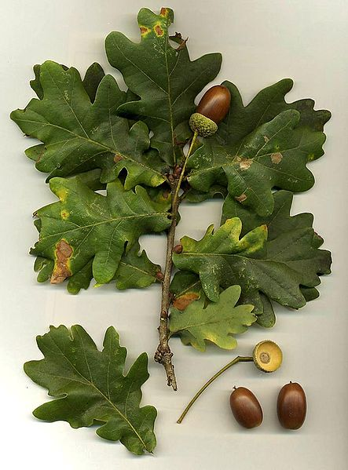
Common Oak
Seeds: Acorns
Oaks are very common in Lagan Valley Regional Park, in fact, Belvoir Park Forest is home to the oldest oak tree in Ireland which dates back to 1642!
Oaks can provide a home for more wildlife than any other Irish tree.
They have lobed leaves and rough bark. You can identify them in winter by their brown buds.
Stories:
Known as the ‘King of the trees’, oaks are a symbol of strength. In the past acorns were often used for fattening pigs.
Uses:
Oak were used to make ships. They are now used to make furniture.

Slide 7
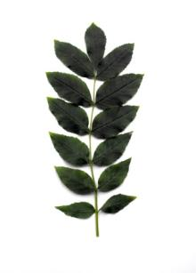
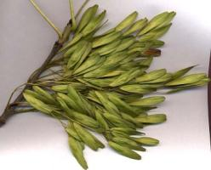
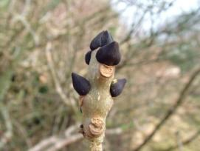
Common Ash
Seeds: Winged keys
Ash is a deciduous tree. It has a leaf that is made up of
6 – 12 leaflets. The leaflets are oval shaped with a toothed edge. It has smooth bark and is easy to spot in winter because it has black buds.
Stories:
People used to believe the opening of the buds could predict the weather: if oak buds were seen to open first, the summer would be dry, while if the ash buds opened first, the weather would be wet.
If the oak before the ash, then we’ll only have a splash.
If the ash before the oak, then we’ll surely have a soak!
Uses:
Used for making hurley and hockey sticks, tool handles and longbows.
Ash leaf
Ash keys
Ash bud

Slide 8
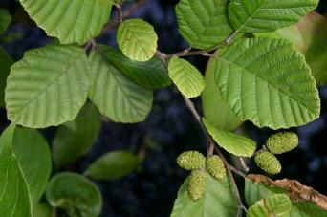
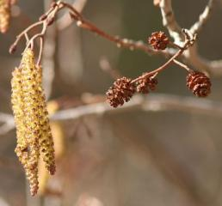
Common Alder
Seeds: Cones
Alder is a small deciduous tree that loves to grow in wet habitats. You can see them growing along the River Lagan. Alder leaves are rounded, toothed, dark green and shiny. Alder flowers are called catkins, you can see them in spring. Alder can be identified in winter by its cones and purple buds.
Stories:
It’s known as the ‘King of waters’. When alder is cut the sap is red. In ancient Ireland warriors made their shields from alder as they believed the red sap was the blood of their enemies.
Uses:
It’s resistant to rotting so was used to make small boats. It makes an excellent charcoal for gunpowder.
Alder leaves
Catkins & cones

Slide 9
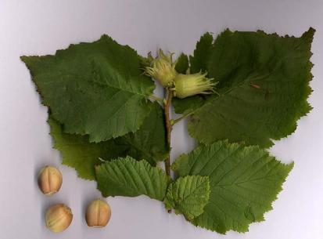
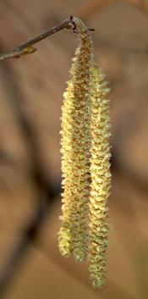
Hazel
Seeds: Hazel nuts
Hazel is a deciduous tree. Its leaves are almost round in shape but with a sudden sharp point at the end and they feel like velvet when touched.
Hazels’ yellow catkins (lambs’ tails) appear in early spring.
Stories:
It was known as the ‘Tree of knowledge’ and a hazel staff is supposed to protect you against evil spirits.
Uses:
Hazel nuts were a great food source for early man and are still loved by wildlife, especially red squirrels.
Hazel leaves & nuts
Lambs’ tails

Slide 10
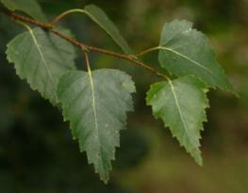
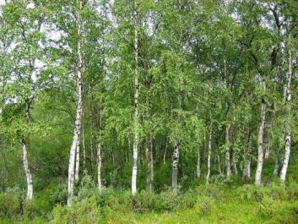
Silver Birch
Seeds: Nutlets
Birch are medium sized, deciduous trees. The bark is silvery and often has dark patches.
Birch have small, dark green, diamond shaped leaves.
Seeds are contained in brown fruit clusters.
Stories:
Birch are associated with birth and young children. Birch twigs were often put beside cradles for protection. It is said witches used birch trees to make their brooms.
Uses:
The sap, bark, leaves, twigs and roots were used for food and medical treatments.
Birch leaves
Birch trees with silvery bark

Slide 11
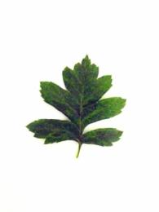
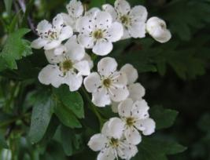
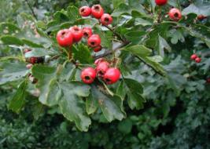
Hawthorn
Seeds: Red berries called ‘haws’
Hawthorn are deciduous trees which are usually found in hedgerows. They have thorny branches and berries called haws. Leaves are small and look like fairy wings. Its flowers appear in May and can be white or pink and are often referred to as May flower.
Stories:
Hawthorn is a symbol of magical powers and fairies. It has always been regarded with a mixture of fear and respect. There are many stories of harm or even death coming to those who interfere with the ‘fairy thorn’.
Uses:
Used widely as a hedge providing an excellent habitat for many small mammals, birds and insects. It was also used as a herb to lower blood pressure.
Hawthorn leaf
May Flower
Haws

Slide 12
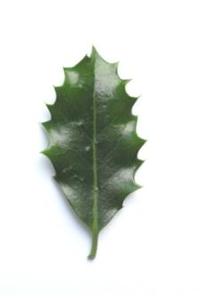
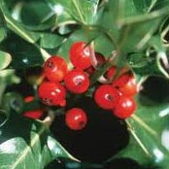
Holly
Seeds: Red berries
Holly is an evergreen tree, that can grow between 10 and 25m in height. Its leaves are spiky.
Many people associate holly with bright red berries however, it’s only the female plant that produces these berries. Its flowers are pink and white and usually appear in May.
Stories:
Long associated with Christmas as it was thought to protect the house against evil spirits. In Ireland holly was seen as a noble tree and you would annoy the fairies if you misused it.
Uses:
Berries are important food source for wildlife during the winter.
Holly leaf
Holly berries

Slide 13
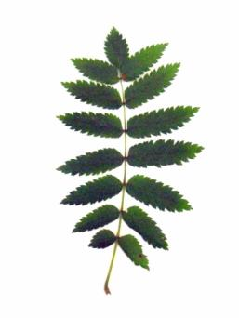
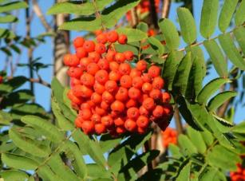
Rowan
Seeds: Red berries
Rowan is a small deciduous tree. It’s leaves have 15 leaflets arranged in pairs with a single leaf at the tip. It produces masses of red berries in autumn and is easy to identify in winter by its purple buds.
Stories:
The name rowan means ‘Wizard’s tree’. In Ireland it was planted near houses to protect them against spirits.
Uses:
Was used to make bows in the middle ages, as well as tools, bowls and plates. The berries can be eaten and were used in jams.
Rowan leaf
Rowan berries

Slide 14
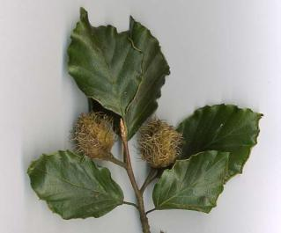
Beech
Seeds: Beech nuts
Beech is a deciduous broadleaved tree that can grow up to 40m in height. The beech has a smooth silver-grey coloured bark. Leaves are dark green and oval, they are shiny and feel waxy. In the autumn the leaves turn a rusty red colour and remain on the tree.
Stories:
Beech trees are wishing trees. If you find a fallen branch from a beech tree this is a gift from the fairies. You can write a wish on it and drive it deep into the earth for consideration by the Fairy Queen.
Uses:
Beech trees are used for hedges as their rusty leaves stay on the trees making them look beautiful all winter.
Smooth & rounded beech leaf
Hairy beech nut

Slide 15
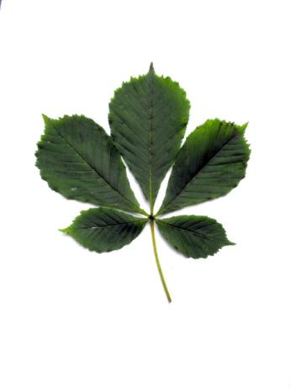
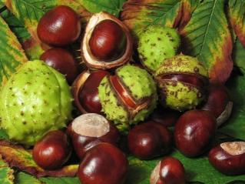
Horse Chestnut
Seeds: Chestnuts (Conkers)
Horse Chestnut trees are large deciduous trees. They have a leaf that is made up of 5-7 leaflets. You can easily spot a leaf as it looks like a hand. In the autumn it has massive buds which are sticky to touch.
Stories:
This tree is said to get its name from the horse shoe marks that are left on a branch when a leaf drops in autumn. Some people believe it’s where fairies tiny horses have been!
Uses:
Conkers can be used for a game where you have to try and pick the biggest one you can find tie it to some string and smash your opponents conker.
Horse chestnut leaf
Conkers

Slide 16
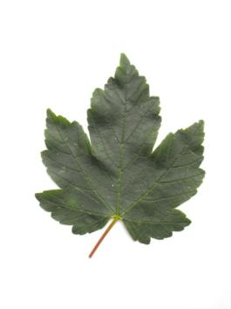
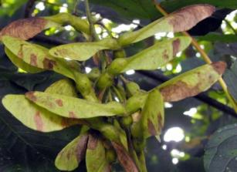
Sycamore
Seeds: Winged seed or ‘helicopter’
Sycamore trees are large deciduous trees. They have large flat leaves with 5 points. The leaves usually have a red stem.
Stories:
Sycamore doesn’t have any ancient stories because it is not native to Ireland. But children used to use the helicopter seeds in flying competitions.
Uses:
It is used to make furniture because it is as strong as oak but it doesn’t last as long.
Sycamore leaf
Helicopters

Slide 17
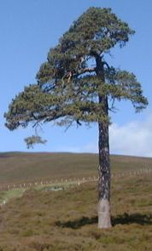
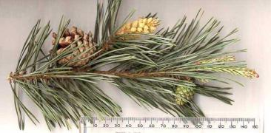
Scots Pine
Seeds: Cones
Scots pines are one of only two native evergreen coniferous trees in Lagan Valley Regional Park. They have a long straight trunk with a spreading canopy. Its leaves are long needles. Scots pine seeds form inside cones which appear between May and June.
Stories:
Scots pines were planted around farms as wind breaks.
Uses:
Scots pine wood is used in many parts of the home including roof timbers, stairs, and doorways. It looks attractive and is popular for making furniture as well as telegraph poles, fences and paper pulp.

Slide 18
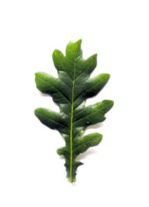

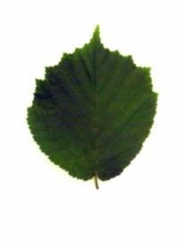

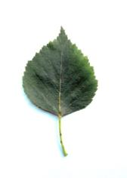
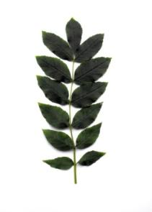

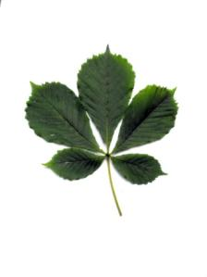
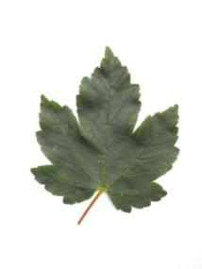
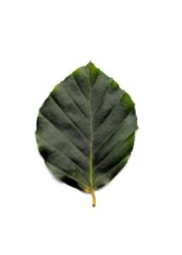
Can you name any of these leaves?
Oak
Birch
Hawthorn
Rowan
Hazel
Ash
Holly
Horse Chestnut
Sycamore
Beech

Slide 19
www.laganvalleylearning.co.uk

